Slide 1
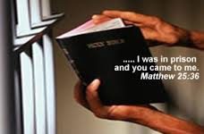
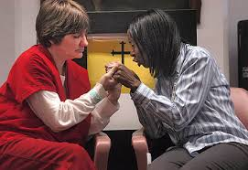
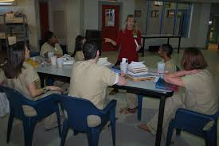
Dispelling Myths about
Prison Ministry
October 14th at 6:30pm
Education Wing
Room 236
Contact Debra Neblett at:
prison@mtzbcministry.com for more information
Notes:
Prison Ministry invites you to a “Meet and Greet” on Tuesday, October 14th in Room 236. Have you embraced our mission to reconcile the world to God through Jesus Christ? Have you thought about how you can serve the Kingdom outside of these 4 walls? Our brothers and sisters need committed volunteers to share the gospel, disciple and mentor them. How about you? Join us as we provide an opportunity to dispel myths about ministering to men, women and youth in the correctional system. PAUSE AND THINK: if it was not for the grace and mercy of God….we could be on the other side of the bars. We are reaching out beyond the four walls and look forward to meeting you on October 14th at 6:30pm. Contact Debra Neblett at prison@mtzbcministry.com for more information.

