Slide 1
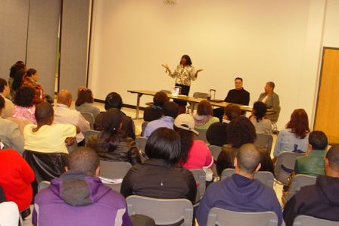
May 30, 2015
9:00am – 2:00pm
Greensboro Medical Society
Closing The Gap:
Healthcare Disparities and
African-Americans Symposium
1301 Alamance Church Road, Greensboro, NC 27401
For More Information: The S.E.L. Group @ 336-285-7173
Meet Local Medical Professionals
Expert Led
Discussions
Free Health
Screenings

