Slide 1
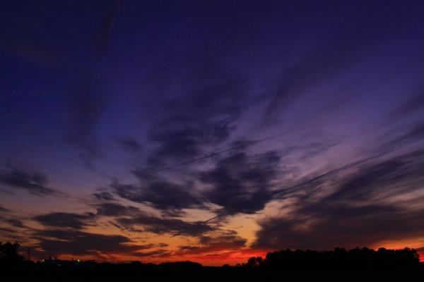
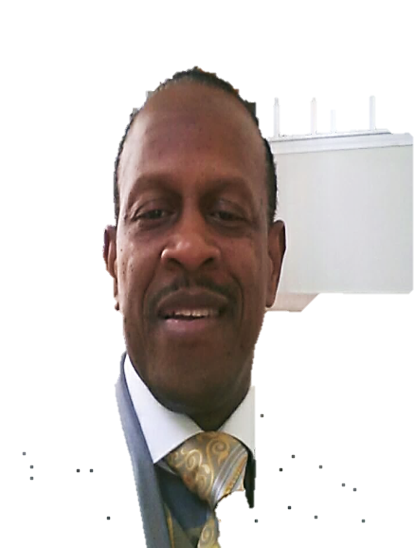
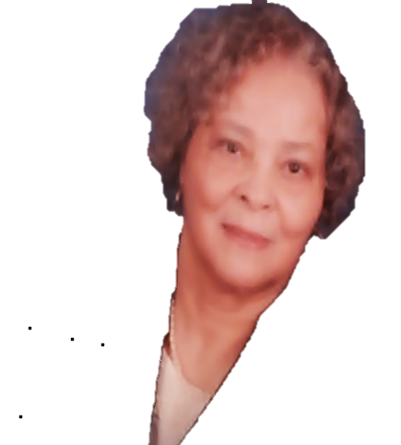
Ministry of A.C.T.S.
(Activating Change Through the Supernatural)
Experience one of the monthly mentoring/training sessions
designed to “EQUIP & EMPOWER” believers to understand and utilize the supernatural gifts of the Spirit for Kingdom living.
For more information please email: moa@mtzbcministry.com
Fresh
Fire
Prophetic Encounter
Min. R. Elliott
2nd Sat, 9-11 am
Room 216
Healing Encounter
Min. R. Burnette
3rd Sun, 9-9:50 am
Room 208
Holy Spirit Encounter
Min. T. Williams
4th Sat, 9-11 am
Room 214
Deliverance Encounter
Min. J. Mason
4th Sat, 11-1:00 pm
Room???

